Slide 1
ERCIYES UNIVESITY FACULTY OF ECONOMICS AND ADMINISTRATIVE SCIENCES
Towards good and better. …

Slide 2
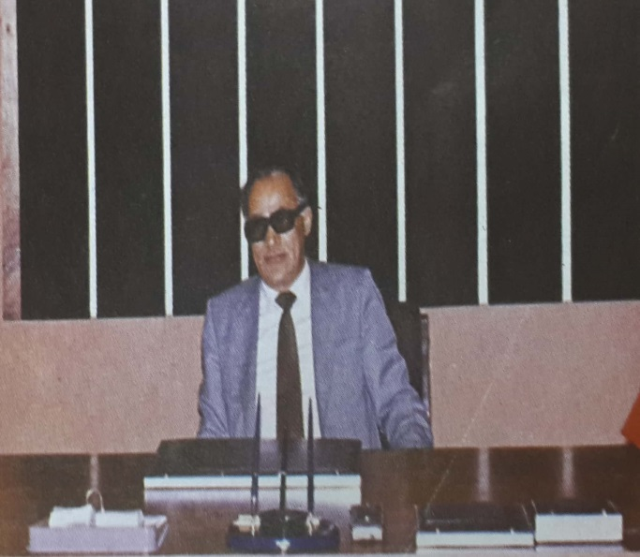
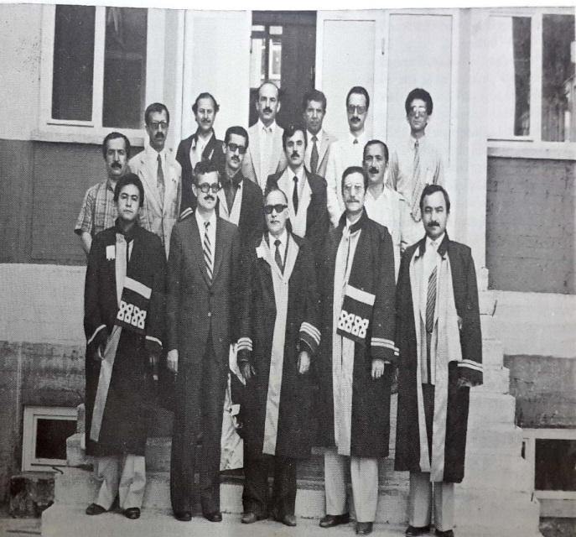
Historical Backround
Our founding dean Prof. Dr. Abdurrahman ÇAYCI:
«After our founding law was passed, education started with the support of Hacettepe University on January 7, 1980 with a total of 75 students.
Our founding dean
Prof. Dr. Abdurrahman ÇAYCI
Our Academic Staff in the Foundation Years

Slide 3
ACADEMIC PROFILE
The distribution of the academic staff in our faculty according to their titles is as follows.;
20 Professors
17 Associate professors
19 Assistant professors
9 Lecturers
19 Research assistants
The Average age of our academic staff : 42,82
The Number of graduate students abroad : 11
The Number of PhD graduates abroad : 8
The Number of people with experience abroad: 27

Slide 4
ERASMUS PROGRAMME (2017-2018)
Department of Business: 8 students sent to Italy, Hungary and Poland
Department of Economics: 9 students sent to Germany, Italy, Poland and Greece
Department of International Relations: 4 students sent to Germany and Hungary
Department of Political Science and Public Administration: 4 students sent to Poland

Slide 5
OTHER STUDENT AND STAFF MOBILITY
Erasmus Staff Mobility
1 Lecturer(Italy / 2017-2018 Academic Year)
1 Lecturer(Romania / 2018-2019 2 Academic Year)
Farabi Program(2019-2020 Academic Year)
4 Business Administration Student
4 Economics Student
1 International Relations Student
Mevlana Program (2019-2020 Academic Year)
2 Business Administration Student
1 Economics Student

Slide 6
Important notes:
There are traditions in our faculty, which has a history of 40 years. In other words, it has an institutional culture and structure.
Academic merit is prioritized in academician employment.
Academic performance is encouraged.
There is continuing education for academics with the support of the Rectorate.
We are reducing our student numbers in a planned way.
Students are supported in internships, scientific and social responsibility projects.
Scientific and social activities are tried to be done together with student clubs.
Course information packages are continuously updated.
Students, academicians and the school administration meet regularly and discuss education and training issues.
Decisions in all boards and commissions are taken under free and democratic conditions.

Slide 7
Important Notes:
Our 2019 Annual Activity Report is put on our website in English.
Our strategic plan is put on our website in English.
Our strategic plan, that is, our priorities, are constantly reviewed.
Our faculty was found successful in the internal evaluation of our university in 2019.

Slide 8
ERCIYES UNIVESITY FACULTY OF ECONOMICS AND ADMINISTRATIVE SCIENCES
Towards good and better. …

